Slide 1
ONLINE NOTICE BOARD

Slide 2
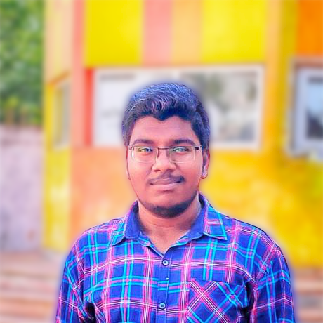
HELLO!
M.Prasad ,
(18A95A0506).

Slide 3
AIM
To create and design a portal where the students can access the circulars and notices by simply logging in.

Slide 4
Online Notice Board is a website where the students can access their circulars related to their college like circulars regarding exam fee payments, workshops registration, or college fests, etc.
In the classrooms all the students may not be present or some may go to workshops, so the information regarding the circulars may not reach all the students. Some students may get information regarding the circulars trough their friends. Some students may know by seeing the circulars which are kept in the noticeboards. All the students may not have sufficient time to read the circulars in the noticeboards.
With this project we can make the circulars that are displayed in the notice boards can be posted on this website and they also can see the old circulars which are not there in notice boards. Students can access the circulars they missed by simply logging in to this website.

Slide 5
TECHNOLOGY STACK
Front End
HyperTextMarkup Language(HTML)
Cascading Style Sheet(CSS)
JavaScript
JQuery
Bootstrap
Back End
Mongo Db
ExpressJS
AngularJS
Node.js
Editor : Visual Studio Code

Slide 6
HOME PAGE
The Home Page consists of :
Home: The user is redirected to a page which consists of sign in and sign up forms.
About: The user is redirected to the which contains description about Online Notice Board.
Contact: The user can view the contact details of Online Notice Board Admin.

Slide 7
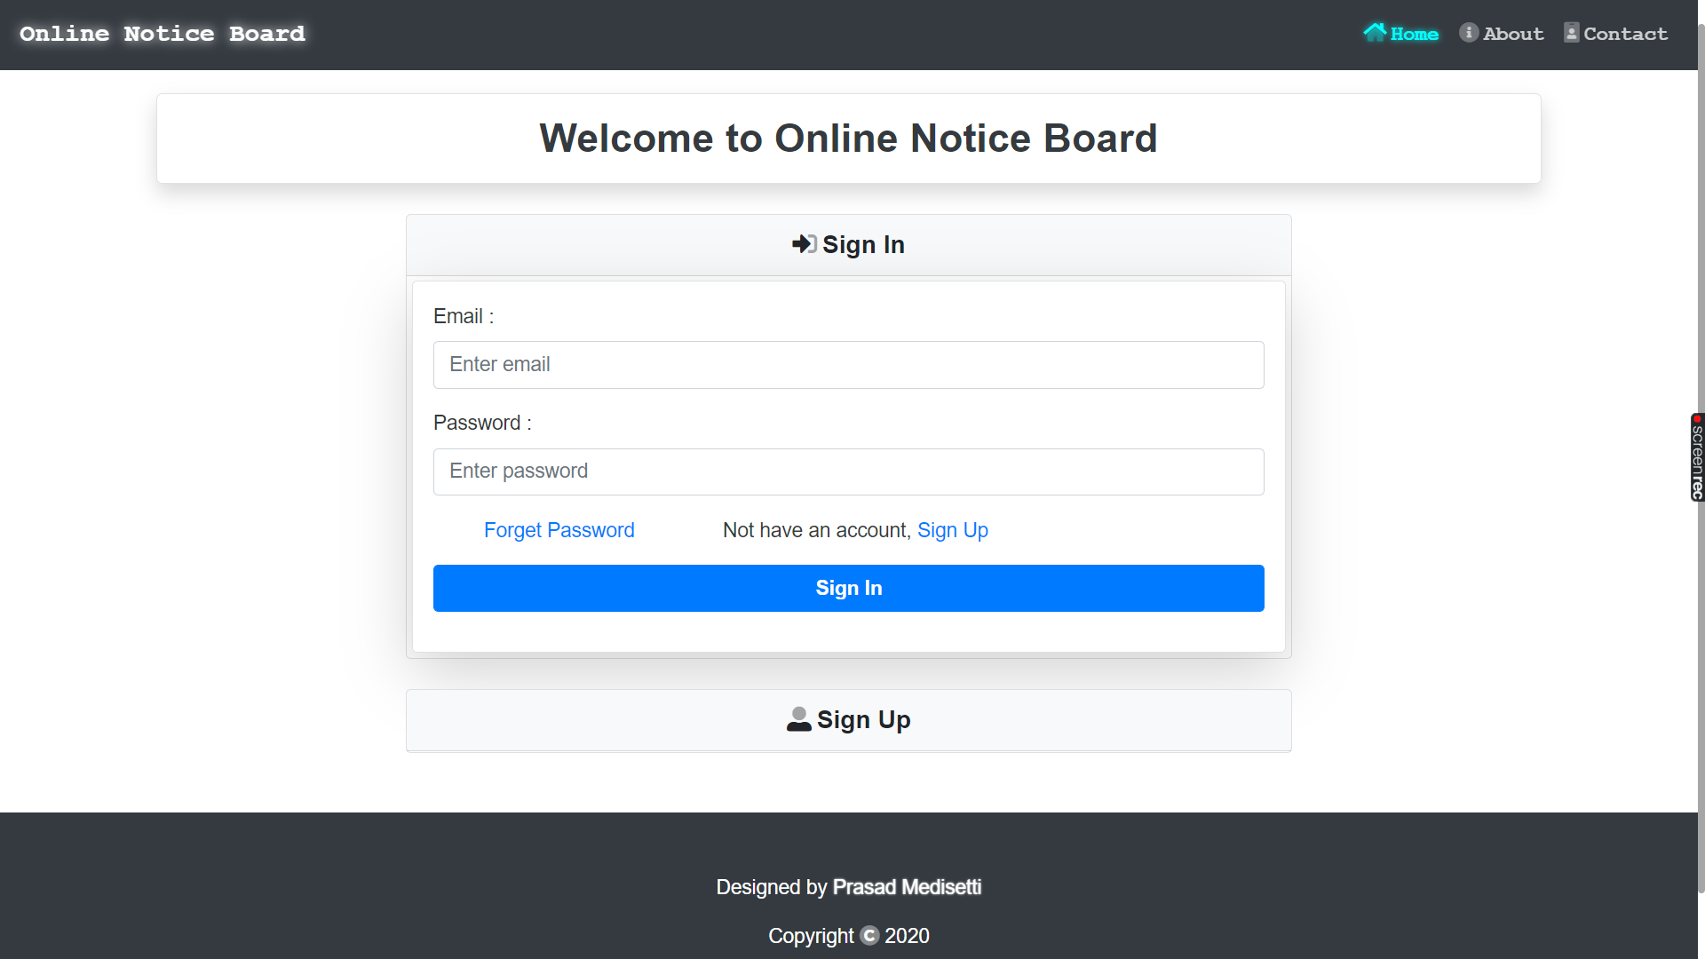

Slide 8
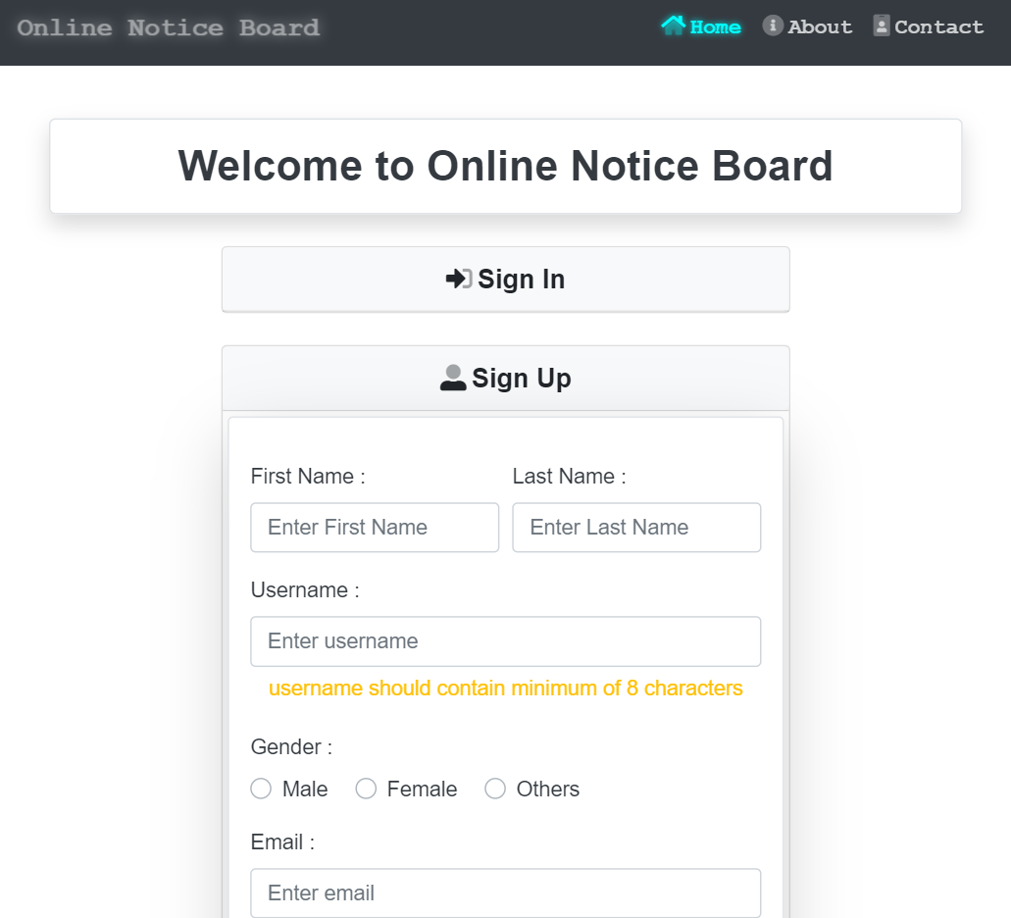
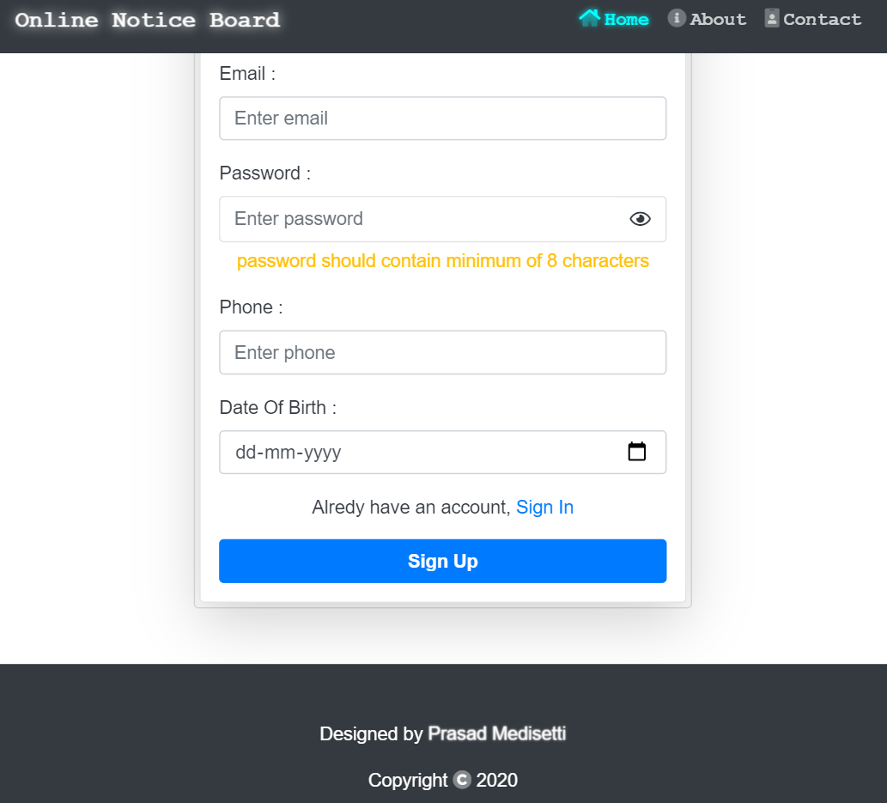

Slide 9
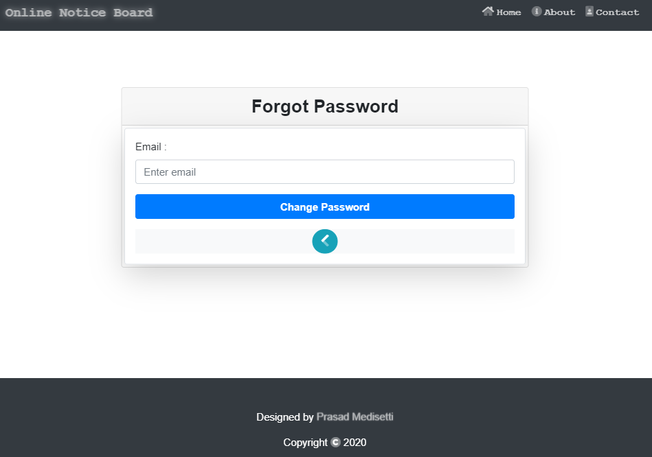

Slide 10
ABOUT PAGE
Through this page the user can understand the aim of this Online Notice Board.

Slide 11
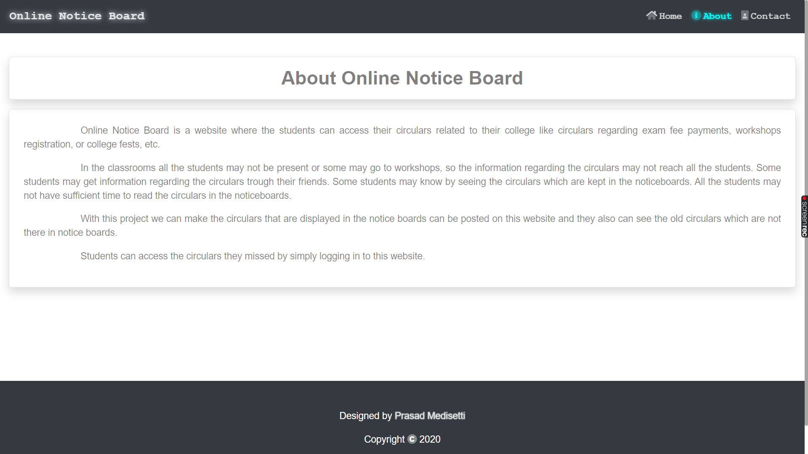

Slide 12
CONTACT PAGE
Through this page the user can contact the adminstrator of Online Notice Board.

Slide 13
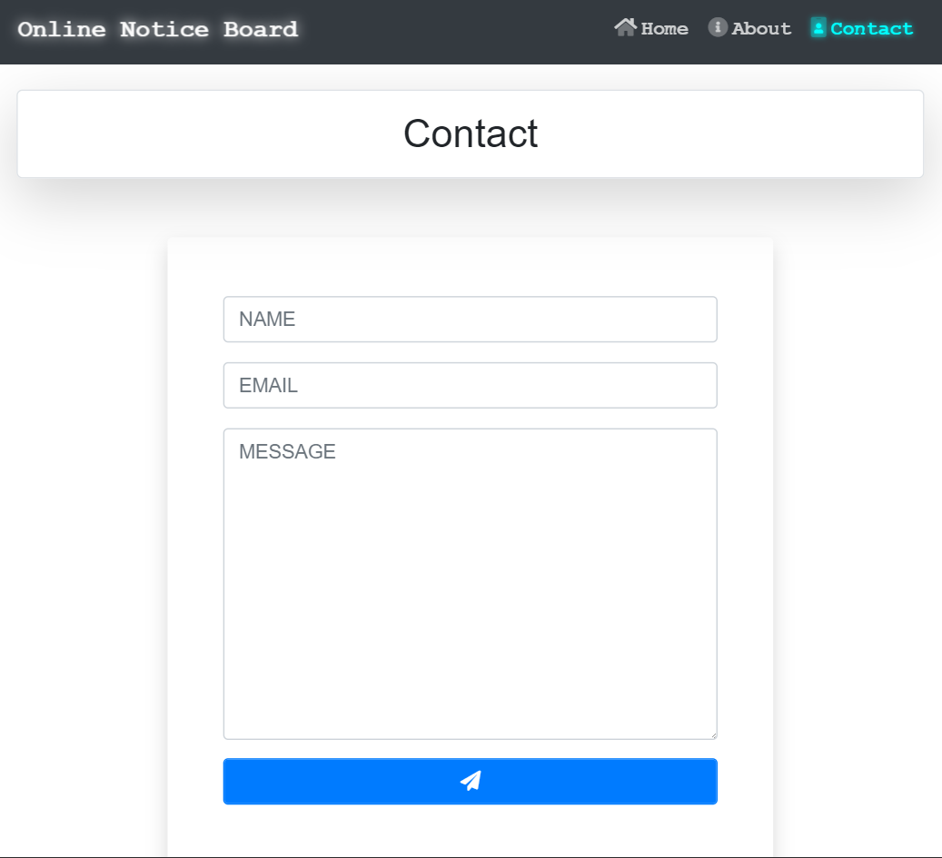
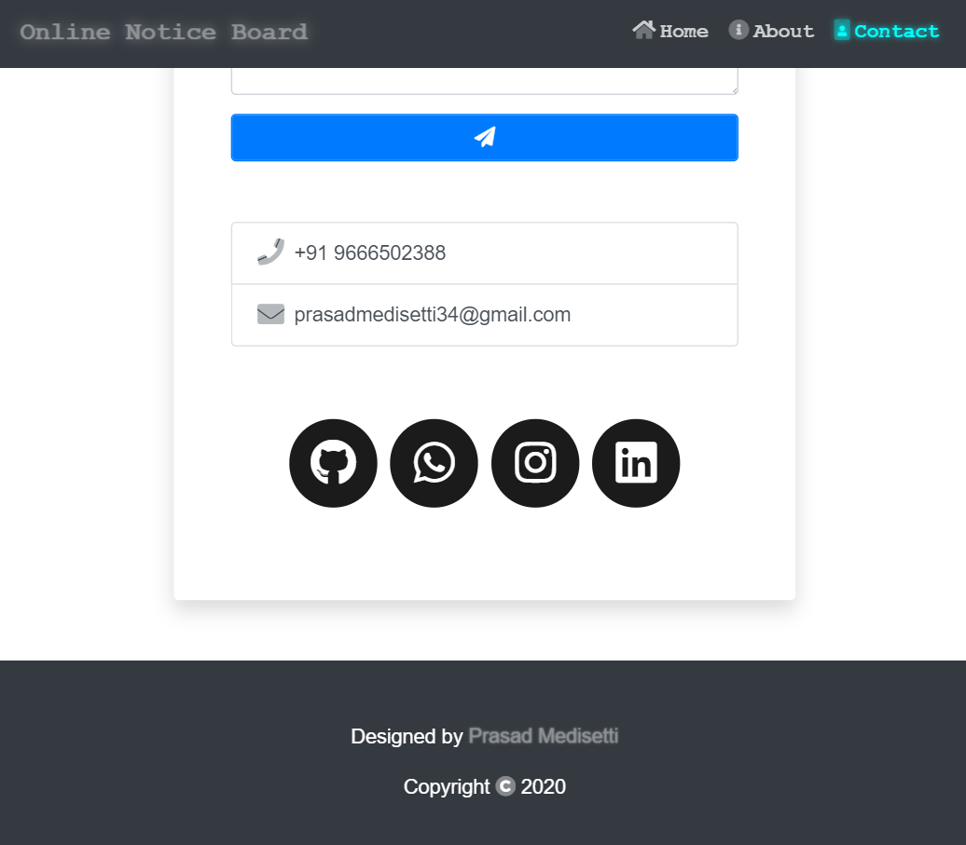

Slide 14
ADMIN LOGIN PAGE
This is the page where the admin can login. After the successful login admin is redirected to dashboard page.

Slide 15
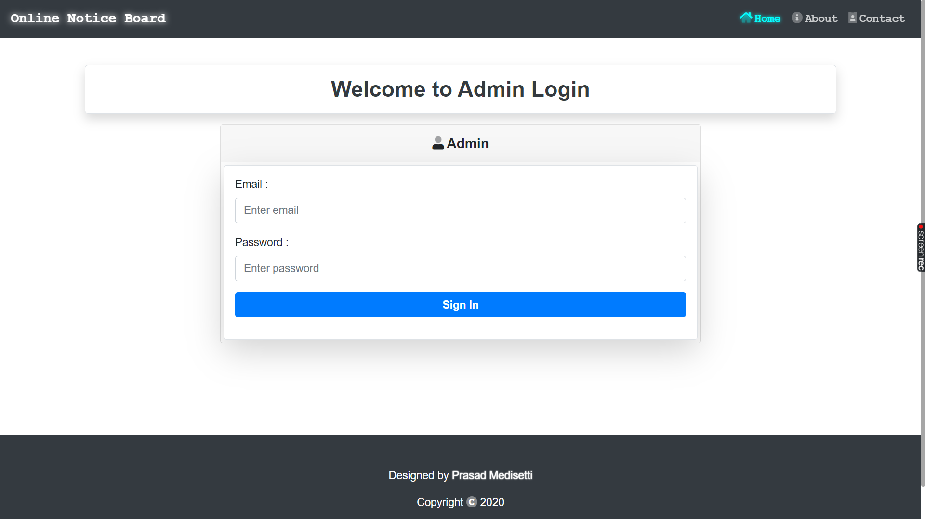

Slide 16
ADMIN DASHBOARD PAGE
This is the page where the admin can manage the posts.

Slide 17
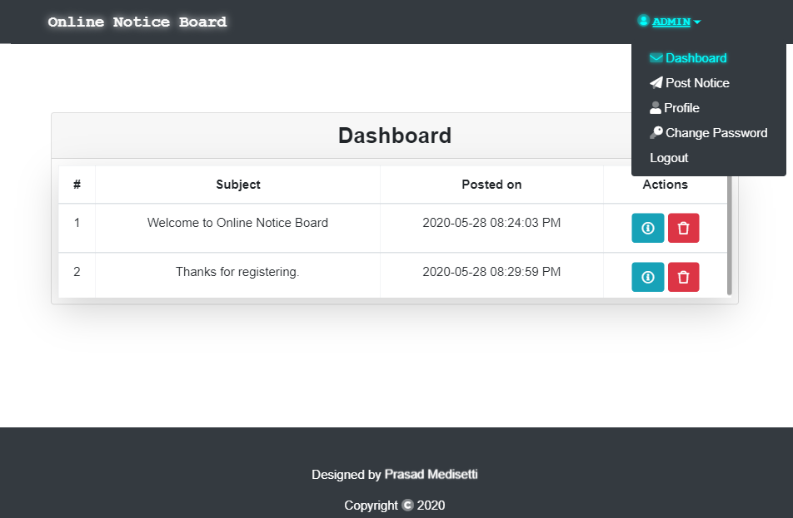

Slide 18
POST NOTICE PAGE
This is the page where the admin can make a new post.

Slide 19
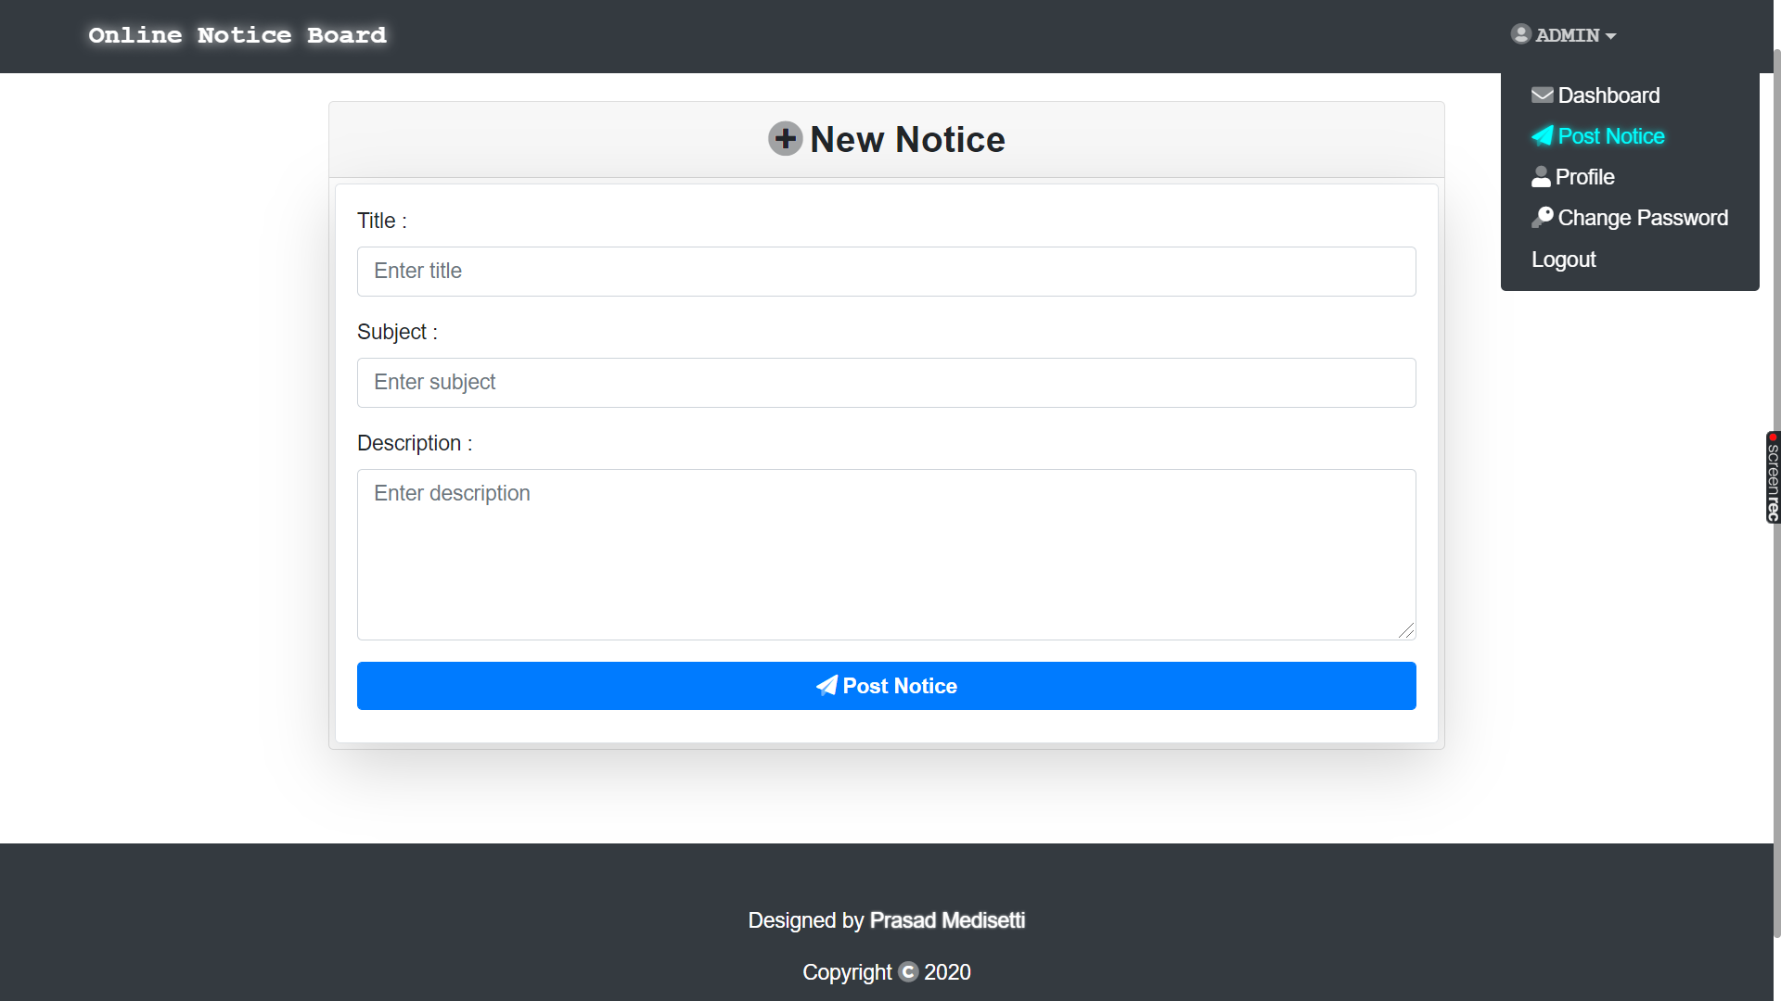

Slide 20
ADMIN PROFILE PAGE
This is the page where the admin can manage his/her profile.

Slide 21
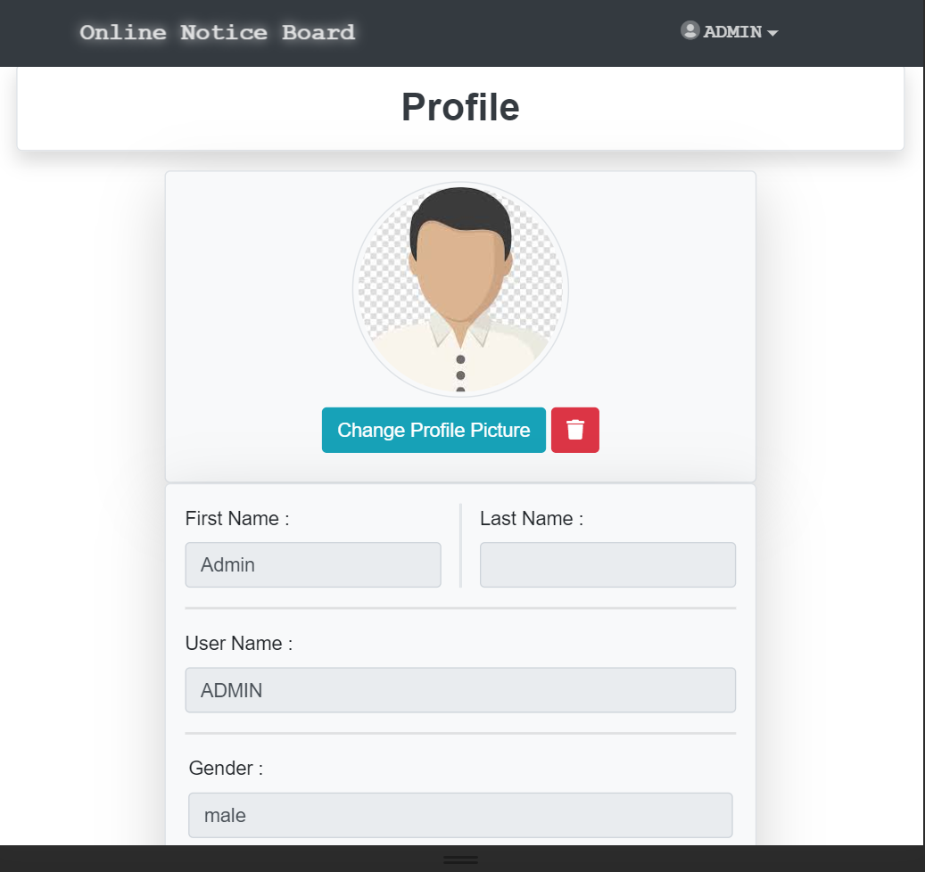
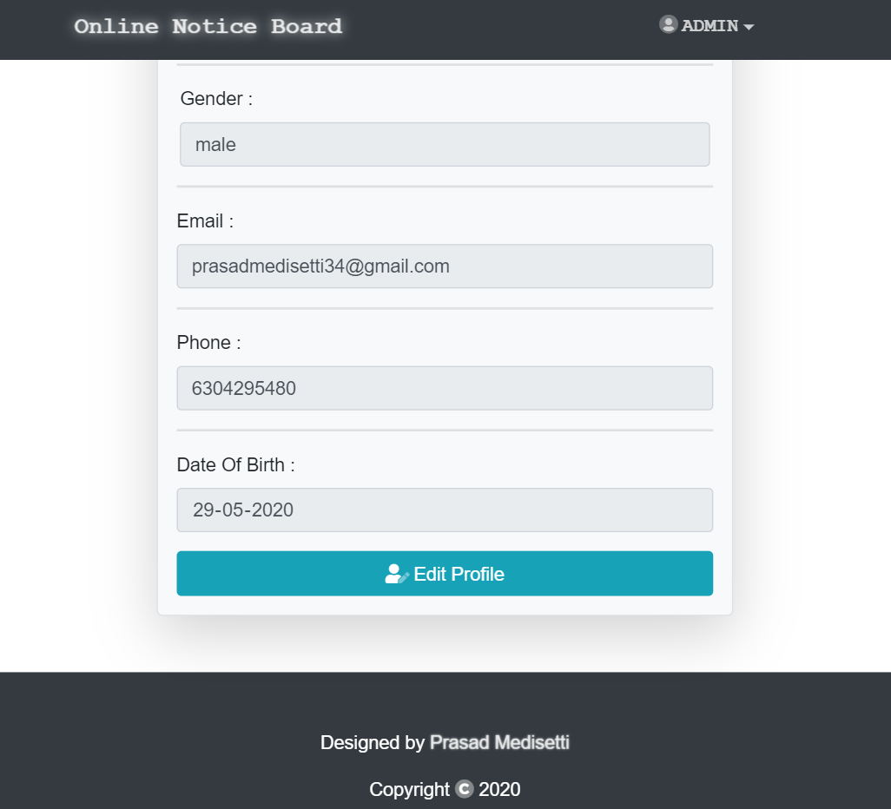

Slide 22
USER CHANGE PASSWORD PAGE
This is the page where the admin can change his/her account password.

Slide 23
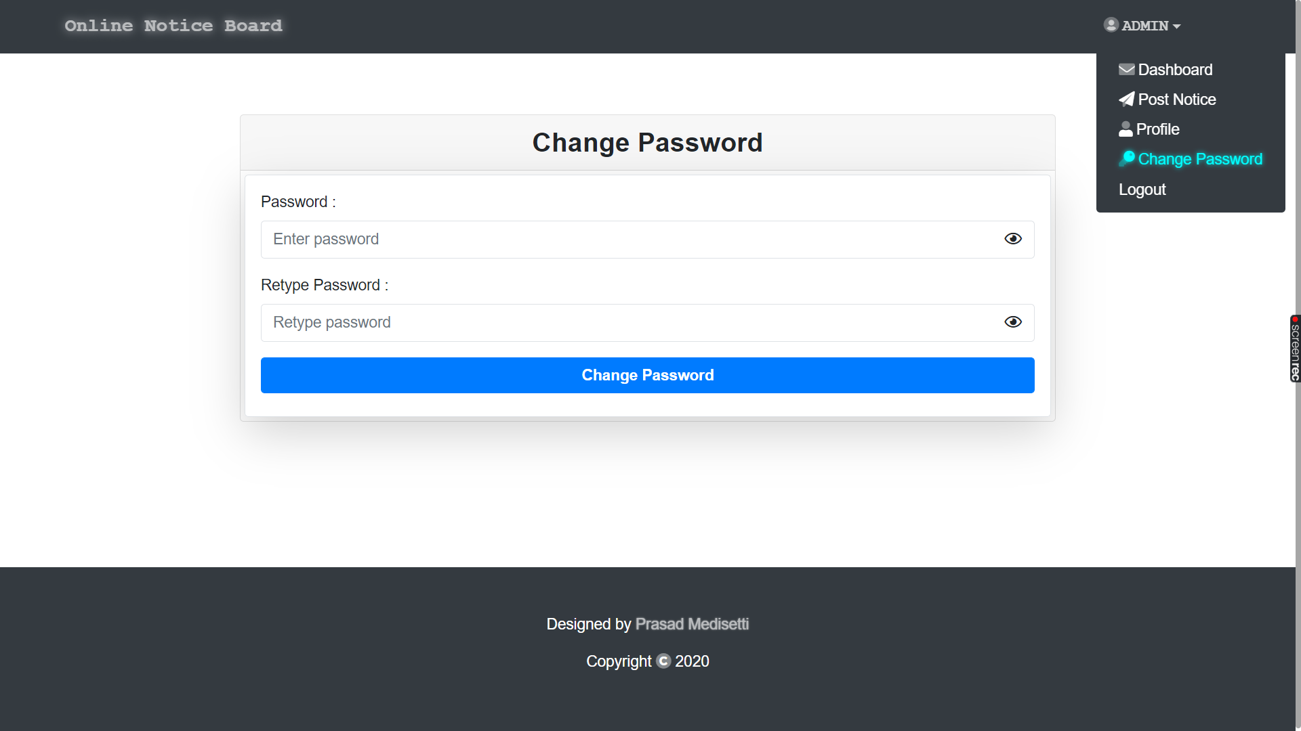

Slide 24
USER HOME PAGE
On this page the user can access all the notifications.
By clicking on icon the user can view more details of that notice.

Slide 25
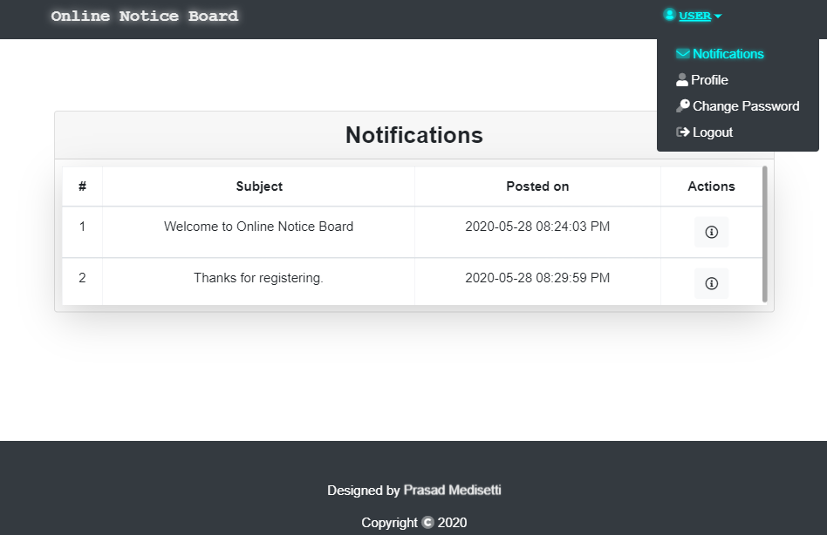

Slide 26
USER PROFILE PAGE
This is the page where the user can manage his/her profile.

Slide 27
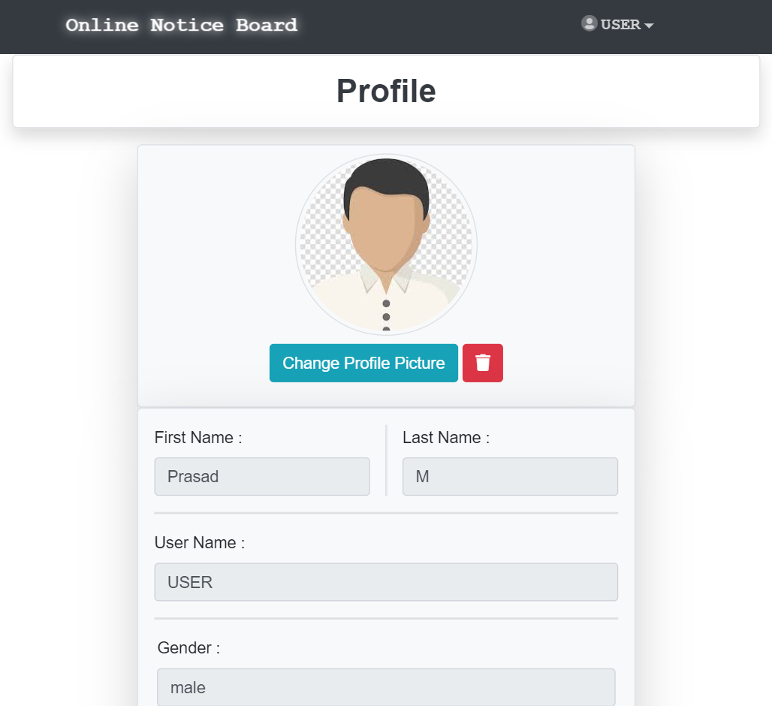
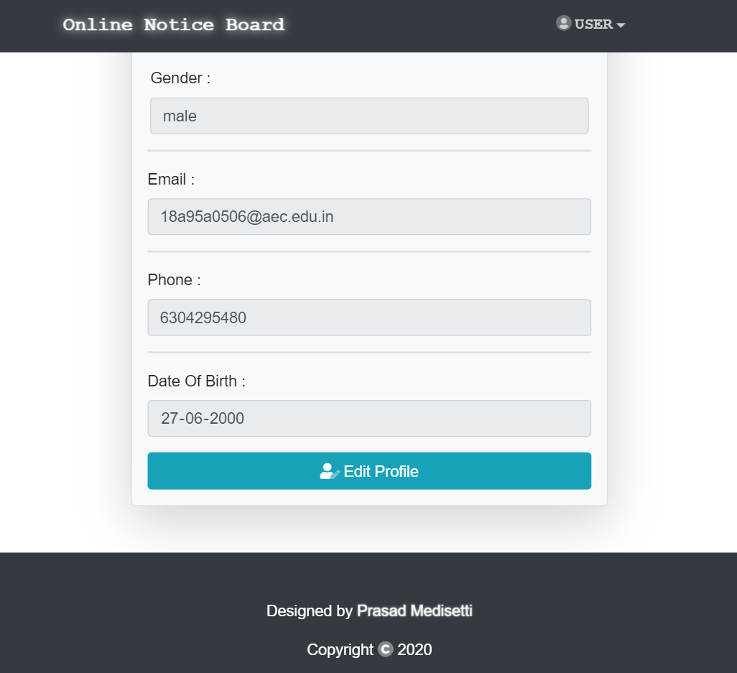

Slide 28
USER CHANGE PASSWORD PAGE
This is the page where the admin can change his/her account password.

Slide 29
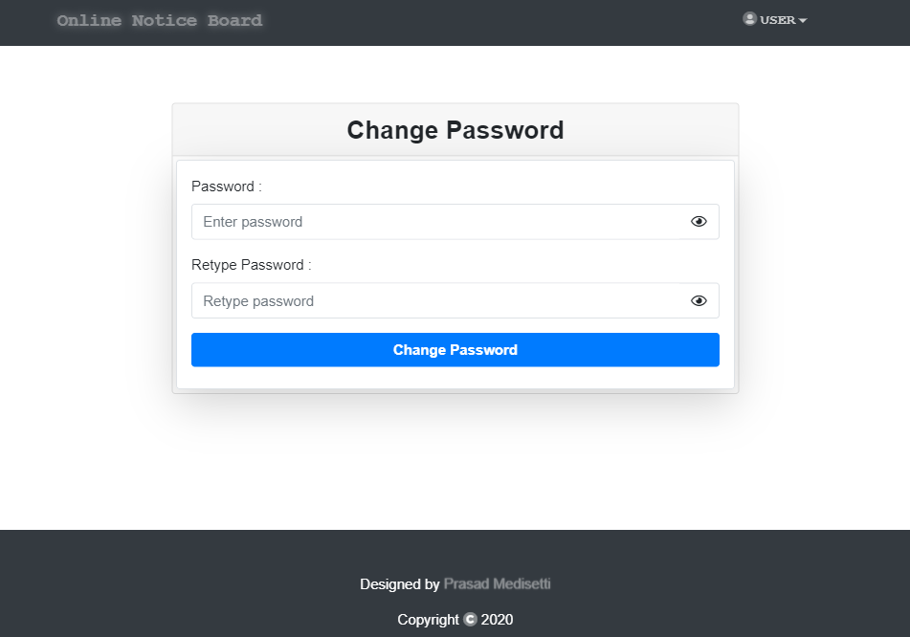

Slide 30


Thank You!
M.Sandeep Siva Sir

